Slide 1




Awakening the giant of
teacher leadership
a presentation by
David Frost
University of Cambridge Faculty of Education
at the
Fifth Expert Seminar on Education Policy
‘Changing the academic and teaching profession’
25th November 2012

Slide 2

Greetings from Cambridge
Notes:
2
Greetings from Cambridge
The independence and freedom that allows us to pursue our scholarly values - of enquiry, critical questioning etc
My entry into this special learning community - not due to elite beginnings but of my work as a teacher.
My beginnings as a teacher - committed to widening access to education
So now I enjoy the benefits of working in Cambridge but I try as much as I can to reach out to communities where teachers are struggling to do the work that I used to do - widening access to education - including those disadvantaged youngsters that can be difficult to teach.

Slide 3
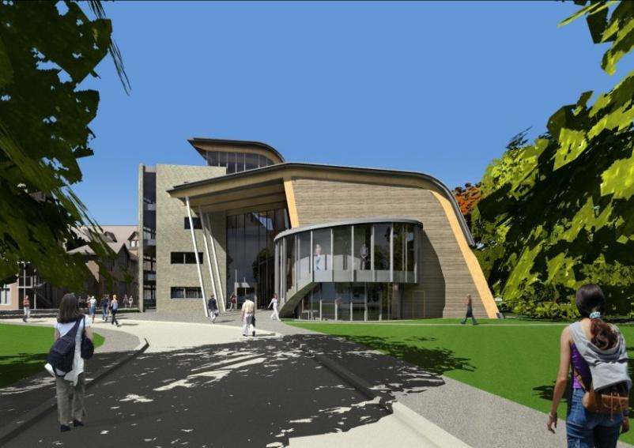
The University of Cambridge Faculty of Education
We welcome anyone involved in education anywhere in the world to engage in postgraduate study.
Notes:
This is the Faculty of Education. We welcome anyone involved in education to engage in postgraduate study.

Slide 4
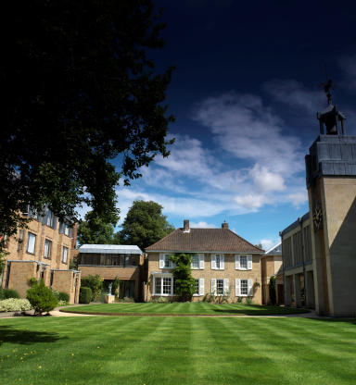
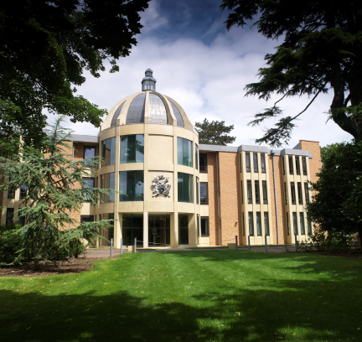
Wolfson College
Cambridge
www.wolfson.cam.ac.uk/
The most cosmopolitan college in Cambridge.
We welcome post-graduate students from overseas.
Notes:
I am a Fellow of Wolfson College. There are 31 colleges in Cambridge but this one is the most cosmopolitan college in Cambridge and we welcome post-graduate students from overseas.

Slide 5


Practical experience over 20 years
A local network
Collaborating with colleagues in 14 other countries

Slide 6
George Bagakis, The University of Peloponnese, Corinth, Greece. Sheila Ball, HertsCam Network, University of Cambridge. Paul Barnett, Barnwell School, Stevenage & HertsCam Network, University of Cambridge Rima Bezede, Educational Centre Pro Didactica, Chisinau, Moldova. Lefki Biniari, experimental Gymnasium of Anavryta, Athens, Greece. Ozgur Bolat, Turkish Education Foundation, Istanbul, Turkey. Ivona Celebicic, proMENTE, Bosnia and Herzegovina. Ciprian Ceobanu, Faculty of Education, Iasi, Romania. Mona Chiriac, Barclay School, Stevenage & HertsCam Network, Cambridge, UK. Kiki Demertzi, 3rd Directorate of Secondary Education of Athens, Greece. Judy Durrant, Canterbury Christ Church University, Canterbury, UK. Maria Flores, University of Minho, Portugal. Sofia Georgiadou, Education Research Centre of Greece, Athens, Greece. Colin Gladstone, Schools Transition Service, Christ Church, New Zealand, Aytac Gogus Sabanci University, Istanbul. Val Hill, Birchwood High School, Bishop Stortford & HertsCam Network, University of Cambridge. Petya Kabakchieva, Sofia University, Bulgaria. Alma Kadić, proMENTE, Bosnia and Herzegovina. Stavroula Kaissari, Petroupolis 2nd Gymnasium, Athens, Greece.
Suzana Kirandziska, Foundation for Educational and Cultural Initiatives Macedonia. Pavlos Kosmidis, Directorate of Secondary Education of East Attica, Greece. Milica Krulanovic, Ratko Zaric Primary School, Niksic & Pedagogical Center of Montenegro. Ljiljana Levkov, University of Belgrade & Ministry of Education, Serbia. Iris Marusic, Centre for Educational Research and Development, University of Zagreb. Gordana Miljevic, Open Society Institute Education Support Programme, Belgrade. Melinda Mula, Kosovo Education Centre, Pristina. Jo Mylles, Sir John Lawes School, Harpenden & HertsCam Network, University of Cambridge. Eugen Palade, Centre Education 2000+ (CEDU), Romania. Anca Nedelcu, University of Bucharest, Romania. Ljubica Petrovic, Agency for Mobility and EU Programmes, Zagreb, Croatia. Viorica Postica, Educational Centre Pro Didactica, Chisinau, Moldova. Amanda Roberts, University of Hertfordshire & HertsCam Network, University of Cambridge. Ljilana Sahardtska-Panova, Foundation for Educational and Cultural Initiatives Macedonia. Jehona Shala, Kosovo Education Centre, Pristina. Thanasis Stamatis, Ex-Headteacher of Petropolis 2nd Gymnasium, Athens, Greece. Marianna Tsemperlidou, 3rd Directorate of Secondary Education of Athens, Athens, Greece. Vlasta Vizek Vidovic, University of Zagreb and Institute for Social Research. Jelena Vranjesevic, University of Belgrade, Serbia. Milica Vukcevic, Luka Simonovic Primary School, Niksic & Pedagogical Center of Montenegro. Vivien Wearing, HertsCam Network, University of Cambridge. Boyan Zahariev, Open Society Institute, Sofia, Bulgaria
Notes:
This list illustrates the variety of types of people in the team – some are academics, others are activists in NGOs and others are experienced teachers. We have no union officials but we have experience of working with the NUT which is similar.

Slide 7
George Bagakis, The University of Peloponnese, Corinth, Greece. Sheila Ball, HertsCam Network, University of Cambridge. Paul Barnett, Barnwell School, Stevenage & HertsCam Network, University of Cambridge Rima Bezede, Educational Centre Pro Didactica, Chisinau, Moldova. Lefki Biniari, experimental Gymnasium of Anavryta, Athens, Greece. Ozgur Bolat, Turkish Education Foundation, Istanbul, Turkey. Ivona Celebicic, proMENTE, Bosnia and Herzegovina. Ciprian Ceobanu, Faculty of Education, Iasi, Romania. Mona Chiriac, Barclay School, Stevenage & HertsCam Network, Cambridge, UK. Kiki Demertzi, 3rd Directorate of Secondary Education of Athens, Greece. Judy Durrant, Canterbury Christ Church University, Canterbury, UK. Maria Flores, University of Minho, Portugal. Sofia Georgiadou, Education Research Centre of Greece, Athens, Greece. Colin Gladstone, Schools Transition Service, Christ Church, New Zealand, Aytac Gogus Sabanci University, Istanbul. Val Hill, Birchwood High School, Bishop Stortford & HertsCam Network, University of Cambridge. Petya Kabakchieva, Sofia University, Bulgaria. Alma Kadić, proMENTE, Bosnia and Herzegovina. Stavroula Kaissari, Petroupolis 2nd Gymnasium, Athens, Greece.Suzana Kirandziska, Foundation for Educational and Cultural Initiatives Macedonia. Pavlos Kosmidis, Directorate of Secondary Education of East Attica, Greece. Milica Krulanovic, Ratko Zaric Primary School, Niksic & Pedagogical Center of Montenegro. Ljiljana Levkov, University of Belgrade & Ministry of Education, Serbia. Iris Marusic, Centre for Educational Research and Development, University of Zagreb. Gordana Miljevic, Open Society Institute Education Support Programme, Belgrade. Melinda Mula, Kosovo Education Centre, Pristina. Jo Mylles, Sir John Lawes School, Harpenden & HertsCam Network, University of Cambridge. Eugen Palade, Centre Education 2000+ (CEDU), Romania. Anca Nedelcu, University of Bucharest, Romania. Ljubica Petrovic, Agency for Mobility and EU Programmes, Zagreb, Croatia. Viorica Postica, Educational Centre Pro Didactica, Chisinau, Moldova. Amanda Roberts, University of Hertfordshire & HertsCam Network, University of Cambridge. Ljilana Sahardtska-Panova, Foundation for Educational and Cultural Initiatives Macedonia. Jehona Shala, Kosovo Education Centre, Pristina. Thanasis Stamatis, Ex-Headteacher of Petropolis 2nd Gymnasium, Athens, Greece. Marianna Tsemperlidou, 3rd Directorate of Secondary Education of Athens, Athens, Greece. Vlasta Vizek Vidovic, University of Zagreb and Institute for Social Research. Jelena Vranjesevic, University of Belgrade, Serbia. Milica Vukcevic, Luka Simonovic Primary School, Niksic & Pedagogical Center of Montenegro. Vivien Wearing, HertsCam Network, University of Cambridge. Boyan Zahariev, Open Society Institute, Sofia, Bulgaria
Notes:
This list illustrates the variety of types of people in the team – some are academics, others are activists in NGOs and others are experienced teachers. We have no union officials but we have experience of working with the NUT which is similar.

Slide 8
Gordana Miljevic
Centre for Education Policy, Belgrade
Aleksandra Maksimovic
University of Belgrade, Serbia
Jelena Vranjesevic
University of Belgrade, Serbia
Majda Josevska
Step-by-Step, Skopje, Macedonia
Ivona Celebicic
proMENTE, Bosnia and Herzegovina
Vlasta Vizek Vidovic
Centre for Educational Research and Development, University of Zagreb
Iris Marusic
Centre for Educational Research and Development, University of Zagreb
ITL project experts in our conference today

Slide 9
The Cambridge tradition
Working in respectful partnership with schools, teachers and other organisations
Bringing scholarship and research to bear on the development of professional practice
Creating and disseminating professional knowledge that is rooted in both professional practice and in academic scholarship and research
Using the award-bearing powers of the university (certification, diplomas and degrees) to support teacher and school development

Slide 10
The need for reform and improvement
PISA?
Professional judgment
Are all young people are becoming sufficiently capable?
Are all young people fulfilling their true potential?
Do we have the perfect society populated by perfect citizens?
Is our economy the most enterprising and productive in the world?
Can the frontiers of science and art be pushed any further?

Slide 11
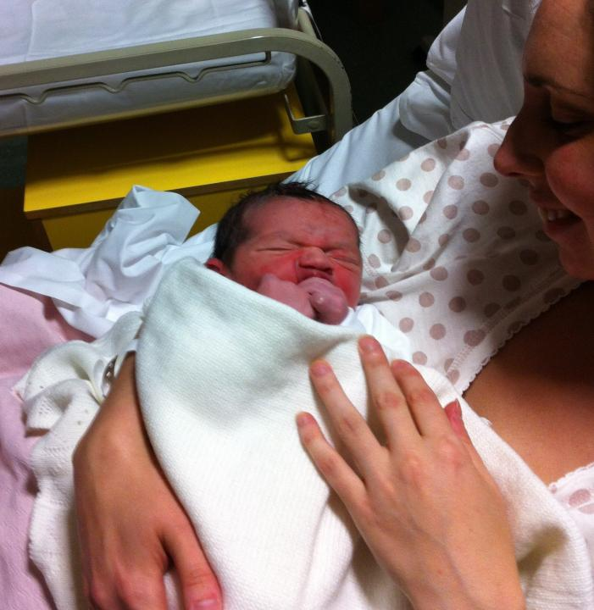
A reminder – why educational reform is so important
Luca
born 10.55 pm
16th Sept. 2012

Slide 12
If we want educational reform
We need learning at all levels: teachers, schools, universities
and the educational system
Learning
= developing new professional knowledge,
new skills
new attitudes
clarification of values

Slide 13
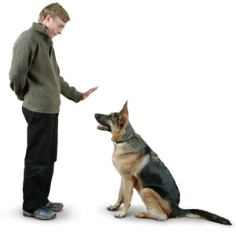
We cannot rely on the implementation through training model – it doesn’t work
it does not develop ‘extended professionalism’
it fails to inspire and cultivate moral purpose

Slide 14
Government
Ministry
District authorities
School principal
Teacher
Classroom practice
Students’ learning
Can the key messages of reform really travel like this?
Let us consider an alternative approach

Slide 15
How much influence
do school principals have
over what happens in classrooms?

Slide 16
How much influence
do teachers have
over what happens in classrooms?

Slide 17
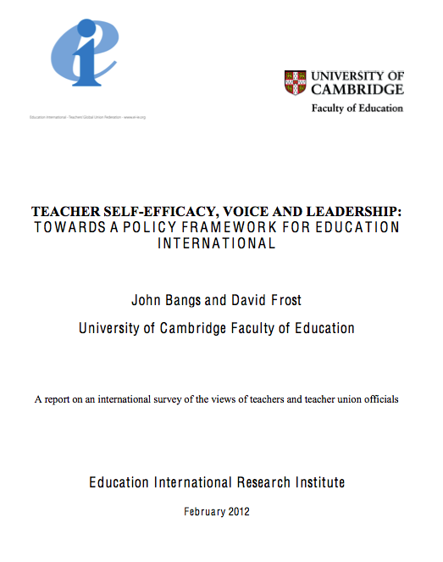
http://www.educ.cam.ac.uk/centres/lfl/researchanddevelopment/policy/educationinternational/
Notes:
In 2010 John Bangs and myself were commissioned to carry out a research project that would support a policy framework

Slide 18
Teacher groups
USA
Macedonia
Hong Kong
UK
Denmark
The Netherlands
Bulgaria
Turkey
Egypt
Greece
Union officials interviews
Australian Education Union
National Education Association
Union of Education, Norway
Canadian Teachers Federation

Slide 19
We are a voiceless profession. There is a sense of despair about the gap between policy and what we know and experience as practitioners.
(Record of discussion, HertsCam, UK group)
Teachers that have a long experience in classrooms do not have a role in developing curriculum. Teachers should participate or at least give feedback on the curriculum.
(Record of group discussion in Greece)
The questionnaire responses indicate overwhelmingly that to have influence on the direction of policy at the level of the system is of the utmost importance to teachers.
(Report for EI, page 15)
Notes:
These comments were collected as part of the survey for Education International. They illustrate the belief that, across the world, teachers are routinely excluded from decision making and the leadership of change but teachers have an appetite for exercising leadership and influencing their professional contexts.

Slide 20
We want the inclusion of us, the ordinary teachers, in the development of documentation, criteria, state educational standards, curricula and textbooks; actually listening to teachers’ opinions.
(Bulgarian teacher)
The teachers would like to play – if not a key role – then at least a bigger role in contributing to the external evaluation of the school e.g. in deciding which topics should be evaluated.
(Record of group discussion in Denmark)
…what would support the sense of self-efficacy.
Knowing that I can influence what happens in the school as a whole; knowing that I can collaborate with others, seek guidance and offers suggestions which will be valued.
(British teacher)

Slide 21
An enabling policy environment
Policy should….
provide opportunities for teachers to exercise leadership in the development and improvement of professional practice.
ensure the right to be heard and to be influential at all levels of policy-making, including the content and structure of the curriculum.
protect and enhance a teacher’s right to determine how to teach within the context of collegial accountability.
support teachers in setting the direction of their own professional development and in contributing to the professional learning of their colleagues.
recognise the key role that teachers have to play in building collaborative relationships with parents and the wider community.
promote the role of teachers in pupil assessment, teacher appraisal and school evaluation.
enable teachers to participate in activities which lead to the creation and transfer of professional knowledge.
Bangs and Frost, 2012: 40

Slide 22
Distributed leadership is essential
It is is recommended by the OECD report on school leadership
Pont, B., Nusche, D. and Morman, H. (2008) Improving School Leadership, Volume 1: Policy and Practice, Paris: OECD

Slide 23
Distributed leadership
According to the OCED report
Build middle management structures
Provide incentives and training

Slide 24
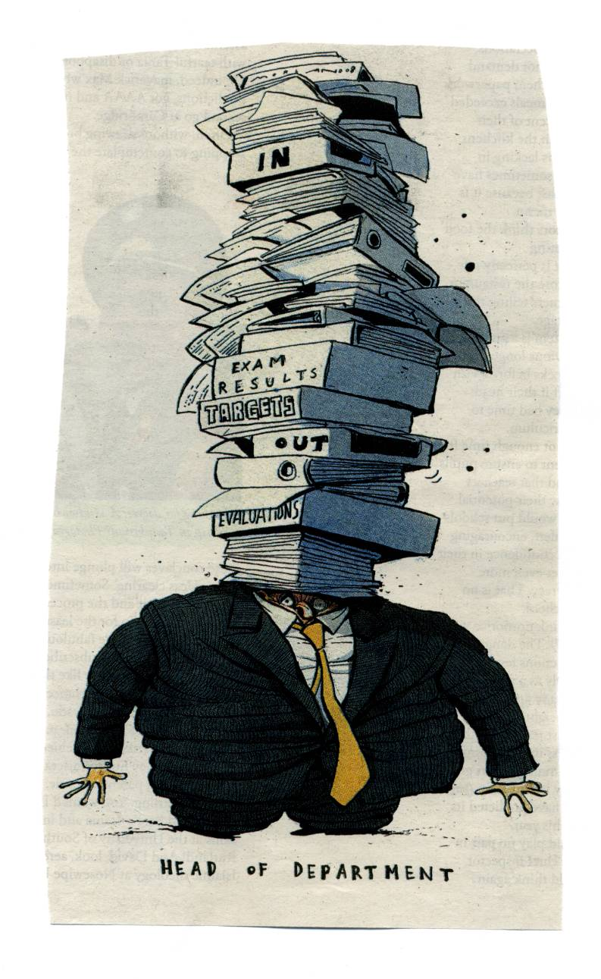
Beware of
managerialist approaches:
only the chose few are designated
complicated organisational structures
influence based on authority because of position
those with leadership positions become overwhelmed by management tasks
Better to enable all teachers to maximise their leadership capacity

Slide 25
Leadership practice
activities such as:
influencing and inspiring others
taking the initiative and setting direction
offering support / service
holding others to account
modelling learning behaviour
valuing / encouraging helpful behaviour

Slide 26
Leadership practice
activities such as:
influencing and inspiring others
taking the initiative and setting direction
offering support / service
holding others to account
modelling learning behaviour
valuing / encouraging helpful behaviour
These can be enacted by any member of the school community

Slide 27
Shared
leadership
Enhanced teaching and learning
professional
culture
learning
change
community

Slide 28
‘Professional learning community’
a term to describe the sort of culture favourable to reform

Slide 29
A professional learning community
(PLC)
Key characteristics
change and innovation are regarded as normal
teachers are willing and able to collaborate
questioning normal practices is welcomed and accepted
gathering evidence and reflecting on it is a normal way to develop practice
a shared sense of moral purpose

Slide 30
Shared sense of moral purpose
This can be expressed as a shared belief that it is of paramount importance to strive to improve practice so that young people in our schools can not only learn as much as they possibly can but can also become good citizens.

Slide 31
School principal’s leadership
Development of a PLC culture
Teachers’ leadership

Slide 32
The school principal takes steps to cultivate a PLC culture and acts directly to support teachers when they take the lead
School principal’s leadership
Teachers’ leadership
Development of a PLC culture

Slide 33
The school principal takes steps to cultivate a PLC culture and acts directly to support teachers when they take the lead
School principal’s leadership
Teachers’ leadership
Development of a PLC culture
Teachers initiate and lead development work which helps the principal to achieve the goals of reform and contributes to changing the culture

Slide 34
The school principal takes steps to cultivate a PLC and acts directly to support teachers when they take the lead
As the PLC culture grows, teachers are more able to lead and the school principal is more able to achieve the goals of reform
School director’s leadership
Teachers’ leadership
Development of a PLC culture
Teachers initiate and lead development work which helps the principal to achieve the goals of reform and contributes to changing the culture

Slide 35
The meaning of the term
‘teacher leadership’
varies

Slide 36
The meaning of the term
‘teacher leadership’
varies
For example:
In the USA the term ‘teacher leader’ has been common since the 1980s to refer to those selected for specific roles to support school improvement
See:
Judith Warren Little (1988) ‘Assessing the prospects for teacher leadership’
Anne Lieberman (1992) ‘Teacher Leadership: What are we learning?’
Recently there has been an attempt to bring together ideas about teacher leadership by a consortium of university and teacher union officials which has produced a document setting out model standards or teacher leadership.

Slide 37
Developments in the USA
Model standards for teacher leaders
The domains
Fostering a collaborative culture to support educator development and student learning
Accessing and using research to improve practice and student learning
Promoting professional learning for continuous improvement
Facilitating improvements in instruction and student learning
Promoting the use of assessments and data for school and district improvement
Improving outreach and collaboration with families and community
Advocating for student learning and the profession

Slide 38
The model standards are helpful in the way they specify the behaviours and actions that teachers might enact but there is a problem as this extract reveals:
Teacher leaders
“…. need recognized responsibilities, authority, time to collaborate, and support from school administrators to assume leadership roles.”
(Teacher Leadership Exploratory Consortium, 2011: 12)
Problem - this document assumes that leadership is exercised only by people who have been designated as having a special role.
Instead, what we need is for all teachers to develop their leadership capacity

Slide 39
Non-positional teacher-leadership
A more inclusive approach
All teachers enabled and supported in developing leadership capacity
A more productive view of professionality
Building capacity for continuous improvement
Building a PLC culture

Slide 40
Awakening the giant
of
teacher leadership

Slide 41
Practical experience over 20 years
A local network
Collaborating with colleagues in 14 other countries

Slide 42



A project with
17 sites in 15 countries
Albania Bulgaria Bosnia and Herzegovina
Croatia Greece Kosovo
Macedonia Montenegro Moldova
New Zealand Portugal Romania
Serbia Turkey UK

Slide 43
The ITL project view of teacher leadership
Non-positional teacher leadership
‘Extended professionality’
Voice / influence
Judgement / choice
Notes:
One of the benefits that should flow from being an ‘extended professional’ is that the teacher has a voice in decision making and can exercise influence within their school and beyond.
We would also expect that extended professionalism involves being free to make professional judgements and to exercise choice about how to teach and other professional actions.

Slide 44
The ITL project view of teacher leadership
Non-positional teacher leadership
‘Extended professionality’
Voice / influence
Judgement / choice
Agency
Notes:
Having voice, being influential, having the freedom to exercise judgement and choice are all underpinned by a theory about human agency (Bandura, 1995). Arguably, human beings are at their most effective and are most fulfilled or satisfied when they are able to satisfy their natural human need to have a sense of purpose and to make a difference to their circumstances. When agency is inhibited demoralisation and depression follow (Frost, 2006).

Slide 45
The ITL project view of teacher leadership
Non-positional teacher leadership
‘Extended professionality’
Voice / influence
Judgement / choice
Agency
Strategic action -
teacher-led development projects
Notes:
In our teacher leadership work teachers are enabled to exercise and develop their agency by taking strategic action. For us this is most effective for teachers in the form of development projects. That is to say – projects which aim to improve and aspect of practice. Projects that are planned in advance and negotiated with colleagues to ensure that the focus is appropriate. Projects that involve collaboration, inquiry and evaluation. Projects take place over a particular time scale, are documented and brought to a conclusion. This makes possible formal recognition in the form of certification.

Slide 46

Our theory about teacher leadership
Teachers can
lead innovation
build professional knowledge
develop their leadership capacity
exercise influence in their schools

Slide 47
Our theory about teacher leadership
Teachers can
lead innovation
build professional knowledge
develop their leadership capacity
influence colleagues and practice in their schools
if they have supportive structures and strategies

Slide 48
Supportive structures and strategies
1. A methodology focused on teachers’ development projects
2. Programmes of support for reflection, planning and sharing
3. Certification – based on a portfolio of evidence
4. Tools to support reflection, planning and discussion
5. Professional cultures favourable to innovation
6. Opportunities for networking beyond teachers’ immediate contexts

Slide 49
Supportive structures and strategies
1. A methodology focused on teachers’ development projects
2. Programmes of support for reflection, planning and sharing
3. Certification – based on a portfolio of evidence
4. Tools to support reflection, planning and discussion
5. Professional cultures favourable to innovation
6. Opportunities for networking beyond teachers’ immediate contexts

Slide 50
1. Methodology based on development projects
Clarifying values and concerns
Agenda for change – subject to negotiation
Action planning – subject to negotiation
Development projects
Professional knowledge

Slide 51
Development work
Impact
On students
(achievement, learning capacity, disposition)
On teachers
(practice, personal and interpersonal capacity)
On schools
(ethos, professional culture, organisational structures)
On systems
(professional knowledge, collaborative links)
Resolving problems
Improving current practice
Refining techniques
Achieving consistency of good practice
Leadership of:
Collaboration, enquiry, evaluation, knowledge building
Adapting materials
Using / trialing new practices
Learning new techniques

Slide 52
A vignette – Gordana’s development project
A teacher in Zagreb was concerned with the challenge her students face when making the transition to specialist subject teaching in the next school year. She talked with pupils about their fears and concerns about subject teachers’ expectations and finding their way to classrooms.
Gordana asked her colleagues if they would meet the students in advance to reassure them and they agreed. She invited her students to make a list of the teachers they would like to meet and send invitations to them. She helped them to organise meetings.
Gordana talked to her colleagues and her students before the meetings to learn about their expectations and again after the actual events to assess how effective they had been. The feedback was positive: students’ curiosity was satisfied and anxieties allayed. They felt that they had understood what would be expected of them; they realised that they already possessed skills, abilities and knowledge needed for the smooth transition. The teachers seem to have gained a clearer picture of the students’ personalities and their prior knowledge.
Gordana provided all her colleagues with an account of her project and hopes to persuade them to build on this experiment to develop more strategies to ease transitions in the future. She also shared an account at a network event involving teachers from other schools in Zagreb.

Slide 53
A vignette – Theodora’s development work
Theodora is a primary school teacher in Moldova. She wanted her students to develop their creativity. She enabled them to work on stories; for example by changing endings to make them happy or sad, inventing new characters, creating new environments and places where the story took place. She presented students with problems and dilemmas and asked them to produce solutions.
In a staff meeting, she told her colleagues about the project; she asked for their opinions and invited them to collaborate. They agreed to use some the activities she had designed. They would observe each others’ lessons and reflect on the way these activities affected students’ attitudes to learning. The teachers met to discuss what they had seen and it was clear that this way of learning made the students more sociable, creative and imaginative. The project continued and a few months later, Theodora and her colleagues noted great changes: students’ motivation had increased, they started to enjoy school and their attitude and behaviour had changed for the better. Even the quiet students were participating more in class. Theodora told her students that she would talk about the project at the ITL conference and she asked them to help her create a display. They chose to tell the story of the project in the shape of a book with each page showing the steps taken and the activities used. They selected clip art images to symbolise the progress of the project.

Slide 54
Supportive structures and strategies
1. A methodology focused on teachers’ development projects
2. Programmes of support for reflection, planning and sharing
3. Certification – based on a portfolio of evidence
4. Tools to support reflection, planning and sharing
5. Professional cultures favourable to innovation
6. Opportunities for networking beyond teachers’ immediate contexts

Slide 55
2. Programmes of support
for reflection, planning and discussion
School-based workshop sessions
A series of sessions (6-10?) after school (2 hours)
Led by tutors who are experienced teachers or external facilitators
Tutors plan their sessions drawing from common tool kit
Sessions planned to support teachers’ projects over a year
Workshops – practical, friendly, supportive ethos

Slide 56
A TLDW group session
This is the third session led by an Carol (Assistant Headteacher) and Sally (an experienced teacher). Participants are considering progress with their development work. Sally leads an activity. She provides a poster with prompts:
‘My development focus’, ‘I’ve done’ ‘I will do’
There is a picture of a padlock with the prompt: ‘I’m stuck on’
Next to this is a with a speech bubble next to it that says ‘please suggest keys/solutions’.
Participants put their posters up round the walls. They are invited to visit each other’s and attach post-its to pose questions or make suggestions or links. Everybody joins in and there is a lot of incidental dialogue as they move around the room. A whole group discussion draws this to a close.
(From the evaluation led by Viv Wearing)

Slide 57


My development focus
I am stuck on……
I’ve done
How to unlock my problem..
Suggestions please
I will do

Slide 58
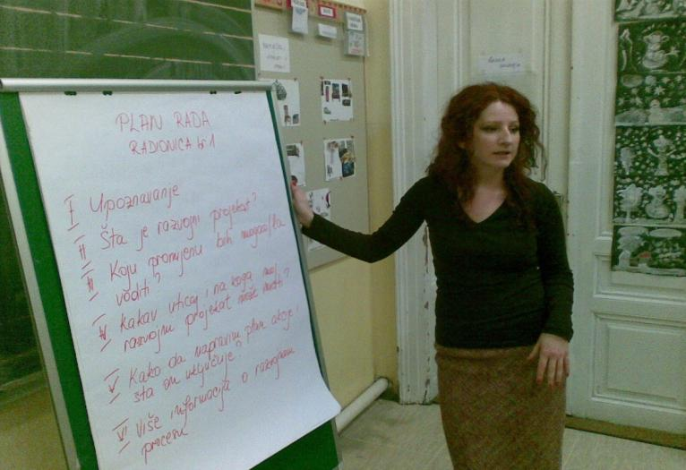
A workshop to support action planning in Sarajevo

Slide 59
Supportive structures and strategies
1. A methodology focused on teachers’ development projects
2. Programmes of support for reflection, planning and sharing
3. Certification – based on a portfolio of evidence
4. Tools to support reflection, planning and sharing
5. Professional cultures favourable to innovation
6. Opportunities for networking beyond teachers’ immediate contexts

Slide 60
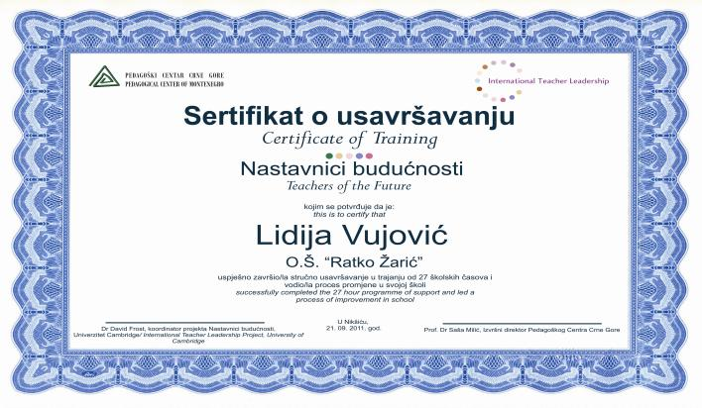
3. Certification and accreditation
- example from Montenegro
Teachers document their development work in portfolios of evidence.
The certificate is awarded by the ITL project and the NGO but recognised by the Ministry

Slide 61
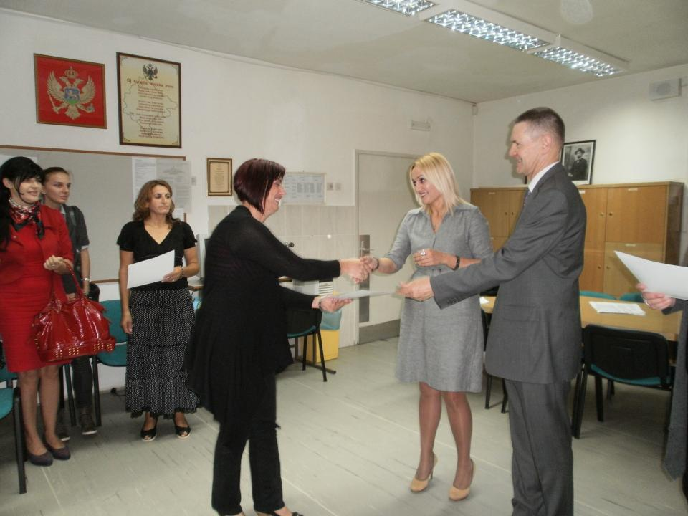

Slide 62
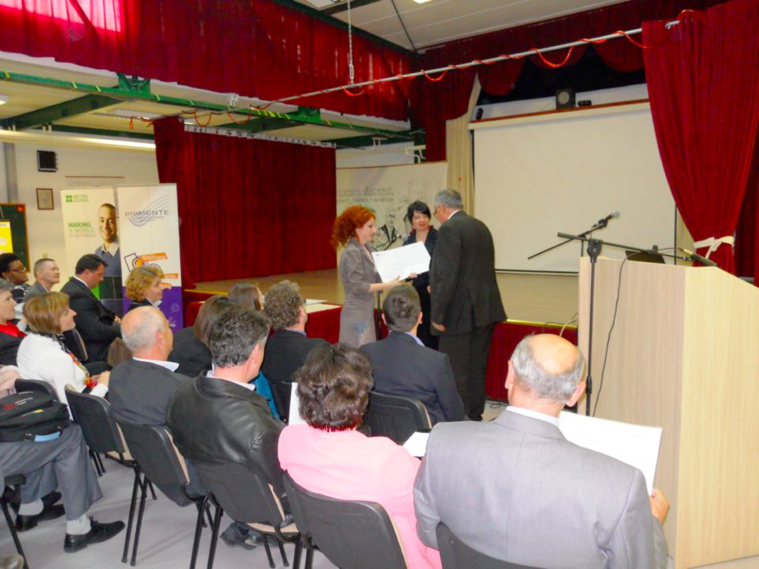
Awarding the certificates at a network event in Sarajevo, 2012

Slide 63
Supportive structures and strategies
1. A methodology focused on teachers’ development projects
2. Programmes of support for reflection, planning and sharing
3. Certification – based on a portfolio of evidence
4. Tools to support reflection, planning and discussion
5. Professional cultures favourable to innovation
6. Opportunities for networking beyond teachers’ immediate contexts

Slide 64

4. Tools to support reflection, planning and discussion
such as:
facsimiles, formats for planning, guide sheets, structures for discussion, workshop activity protocols
to support:
reflection, consultation, project planning, discussion & review

Slide 65
Supportive structures and strategies
1. A methodology focused on teachers’ development projects
2. Programmes of support for reflection, planning and sharing
3. Certification – based on a portfolio of evidence
4. Tools to support reflection, planning and discussion
5. Professional cultures favourable to innovation
6. Opportunities for networking beyond teachers’ immediate contexts

Slide 66
5. Professional cultures favourable to innovation
Culture building –
the school principal’s job
The only thing of real importance that leaders do is to create and manage culture - the unique talent of leaders is their ability to work with culture.
(Edgar Schein, 1985)

Slide 67
Professional learning communities
Characteristics
Shared values and vision
Collective responsibility for pupils’ learning
Collaboration focused on learning
Group as well as individual professional learning
Reflective professional enquiry
Openness, networks and partnerships
Inclusive membership
Mutual trust, respect and support
(Bolam et al., 2005)

Slide 68
Collaboration with school principals – culture building
“It has helped to break down barriers and hierarchies within the school. It is uplifting to see young and less experienced staff leading the learning of those with considerable years of service and rewarding to witness the engagement of non-teaching staff. It has brought an even greater sense of common purpose and teamwork, and extended the ownership of the school’s agenda.”
(Headteacher in a HertsCam school)
School principals build the conditions that favour teacher leadership.
They encourage, support and orchestrate teachers’ development work.
Teacher leadership develops professional learning communities through projects that involve collaboration, inquiry, review, collective reflection etc.

Slide 69
Supportive structures and strategies
1. A methodology focused on teachers’ development projects
2. Programmes of support for reflection, planning and sharing
3. Certification – based on a portfolio of evidence
4. Tools to support reflection, planning and discussion
5. Professional cultures favourable to innovation
6. Opportunities for networking beyond teachers’ immediate contexts

Slide 70
6. Opportunities for networking beyond teachers’ immediate contexts

Slide 71
Impact of teacher-led development projects
Professional development for the teacher concerned
Good projects embed new practices and change the professional culture
But – networks enable teachers to improve the system
building knowledge that is shared and trusted
spreading the virus of moral purpose

Slide 72
Mutual encouragement in Sarajevo
I caught myself participating in discussions with all my heart, getting excited about the most ordinary talk between colleagues from our school and the colleagues from Hrasno. Exchanging ideas, listening to each other with respect, giving support to each other, one gets tremendous self-esteem, and that is all I need. So I managed to go beyond the limits of my previous work, I set my goals on a higher level. Having seen the results of what I initiated, in cooperation with my colleagues, I am encouraged to make new ways to continue something that improves the quality of work with children, which encourages me personally, thereby making me happier.
(ITL Report from Bosnia and Herzegovina)
Notes:
An example of how networking can help a teacher to develop.

Slide 73
Impact of teacher-led development projects
Professional development for the teacher concerned
Good projects embed new practices and change the professional culture
But – networks enable teachers to improve the system
building knowledge that is shared and trusted
spreading the virus of moral purpose

Slide 74
What are we transferring through networking?
What works
Skills, information, tips
Mutual encouragement
Common cause, collective self-efficacy
Moral purpose virus
Parables, inspiration, values
Notes:
Teacher networking is about knowledge building but this is far more than just passing on information or advjce about how to teach.

Slide 75
The virus of moral purpose
At a network event in Veliko Tarnovo, an elementary teacher spoke about her project. She had been faced with a challenge when a nearby school closed and the students were re-distributed to other schools in the city. A group of six Roma children were transferred to her school. The teacher explained that the children lacked basic literacy and it was obvious to her that they had not received even a basic education in the past. She said that they had been effectively excluded from education and she expressed her sense of injustice about this. She explained that she had consulted her colleagues who agreed to meet to discuss what could be done. Together they devised a strategy which included an initial programme of intensive work on basic skills followed by gradual integration into the mainstream class.
(Observation by DF, June 2011)

Slide 76
Changing the system through teacher-led projects
By building networking arrangements
This builds knowledge that is shared and trusted
Most importantly networking spreads the virus of moral purpose

Slide 77
HertsCam Network
2012-2013
Sir John Lawes School, Harpenden
John Henry Newman School, Stevenage
Samuel Ryder Academy, St Albans
Network Event: 19 November, Sir John Lawes School
Stevenage Schools’ Group
Network Event:
1 July, Broxbourne School
R A Butler Infant School, Essex
St George’s School,
Harpenden
The MEd in Leading Teaching and Learning
Leventhorpe School, Essex
Roundwood Park School, Harpenden
Network Event: 21 May, Dame Alice Owen’s School
HertsCam Annual Conference
27th April
University of Cambridge
Birchwood School,
Bishop’s Stortford
Herts & Essex School
Bishop’s Stortford
Sandringham School,
St Albans
Network Event: 28 January, Nobel School, Stevenage
Dame Alice Owen’s School, Potters Bar
Turnford School,
Cheshunt
Network Event: 25 February, Westfield Community College
Mount Grace School,
Potters Bar
Simon Balle School, Hertford
Westfield Community College, Watford
Broxbourne School, Broxbourne
Network Event 15th October
(initial registration)
Birchwood High School
Network Event 15th October
(initial registration)
Sir John Lawes School
Notes:
77
Updated 20 October 2010

Slide 78
The HertsCam Network
7 Network Events – hosted by schools
An Annual Conference – at the University

Slide 79
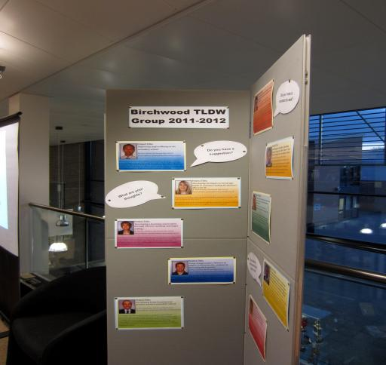
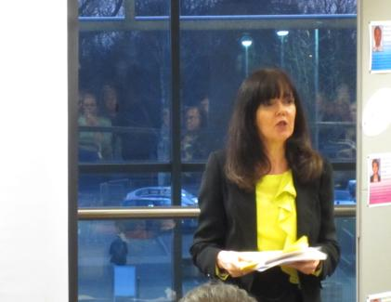
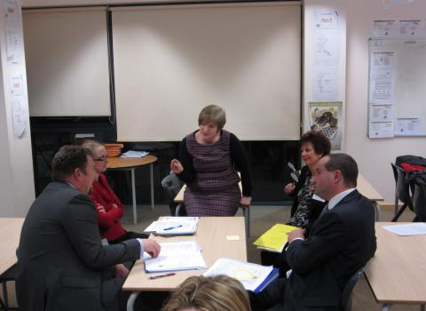
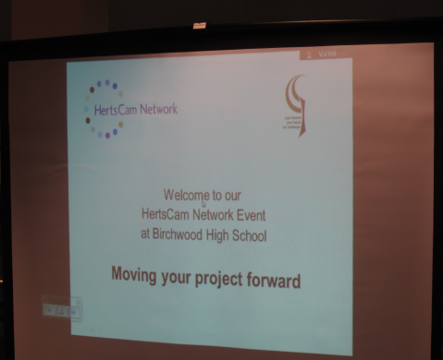
Notes:
The event included displays and workshops led by teachers. Here a teacher shares her work on the development of staff coaching. The other teachers share with her their experience of this.

Slide 80
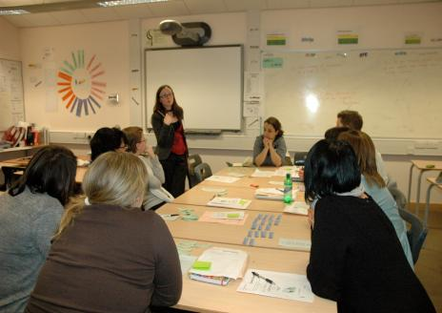
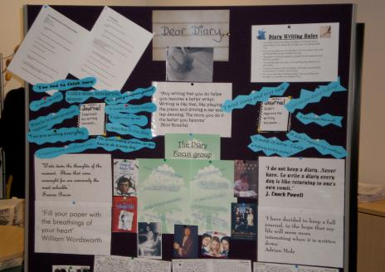
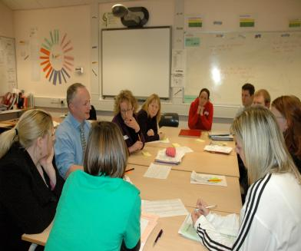
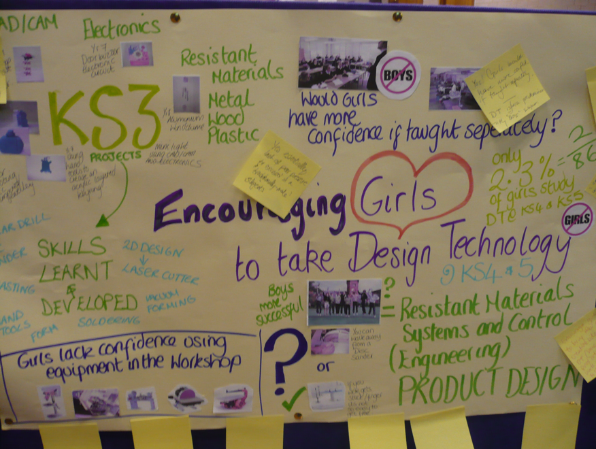
A HertsCam Network Event

Slide 81
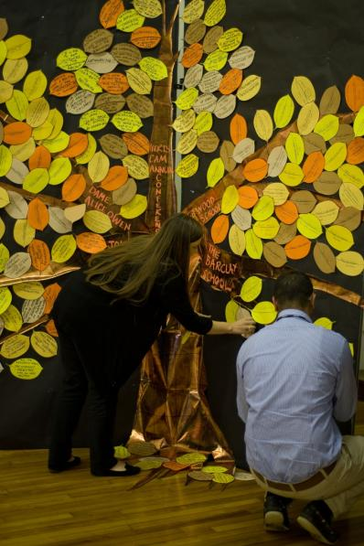
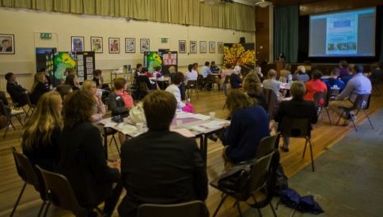
Hosting a Network Event
Organised by teachers
A welcome from the school principal
Plenary meeting and sharing activities
Teacher led workshops
Displays / posters

Slide 82
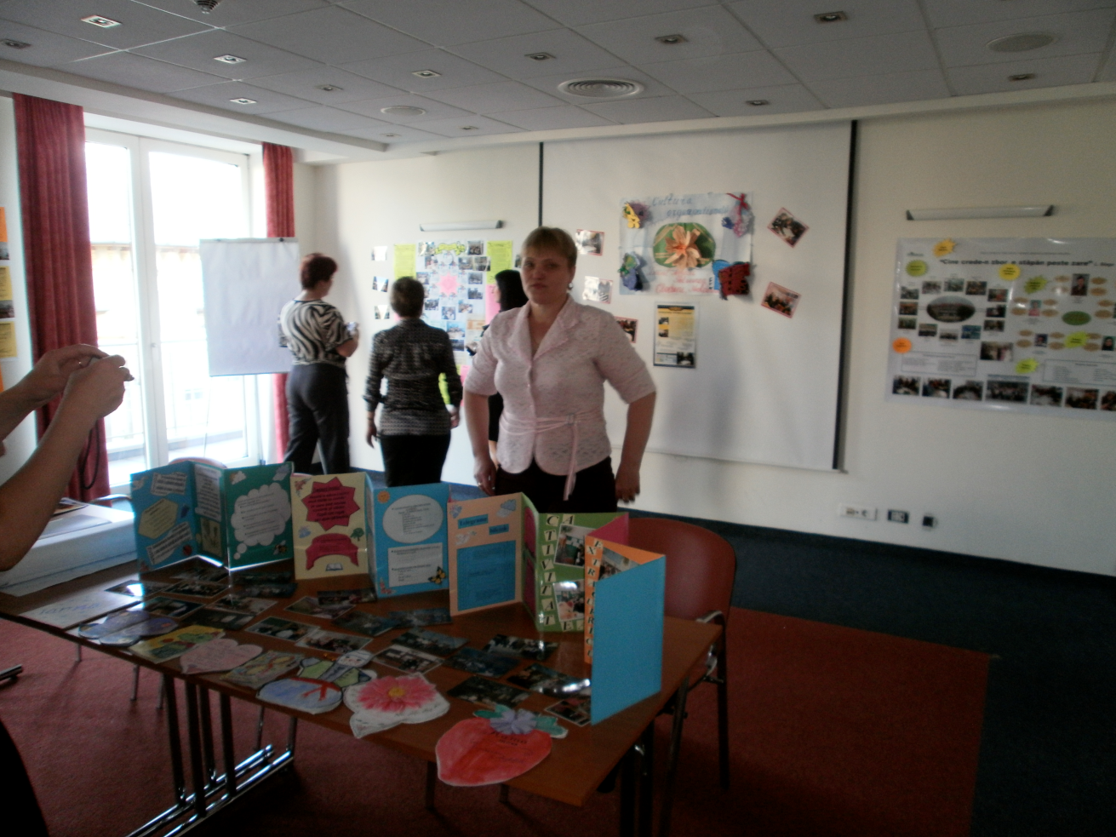

Slide 83
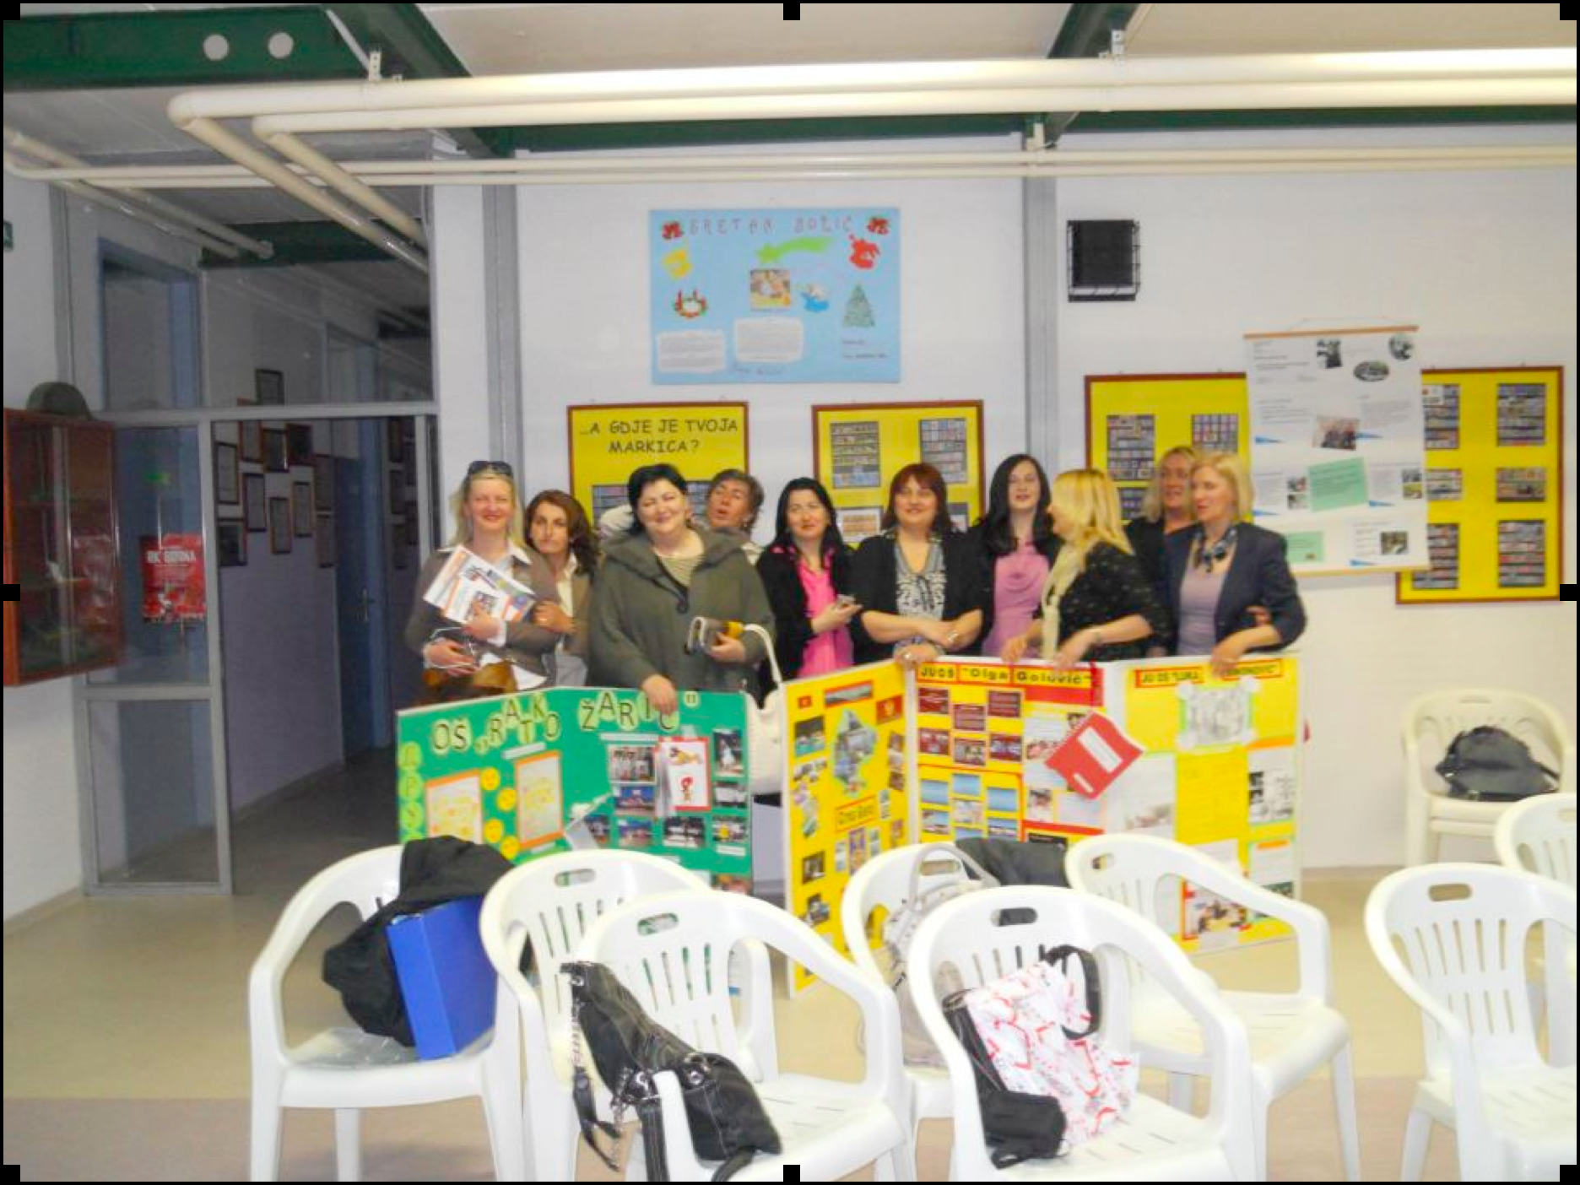
Teachers from Montenegro with their posters at the ITL project network event in Sarajevo

Slide 84
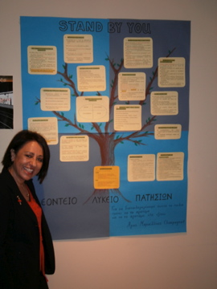
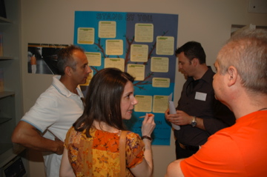
Knowledge building in Athens
The teachers presented their action plans, talked about challenges they face, asked for ideas and help from the others …..They were really enthusiastic and asked for more network events. They were inspired and encouraged.
(ITL project report from Greece)

Slide 85

Facilitating teacher voice
Celebrating teacher leadership
Notes:
The HertsCam Network started this journal to share accounts of teacher-led development work more widely. Now the journal includes material from all over the world. We are looking forward to including something from Kzakhstan.

Slide 86


Slide 87
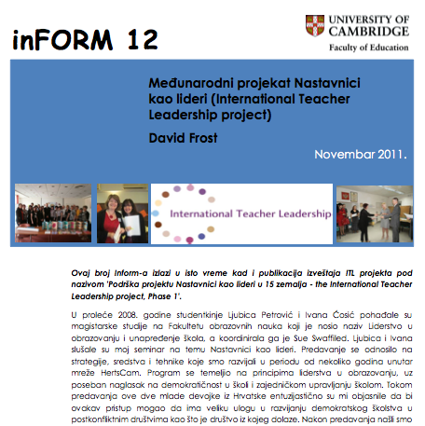
To download this, go to:
www.educ.cam.ac.uk/centres/lfl/
Notes:
If you would like to know more about the International Teacher Leadership project, please download this report.

Slide 88
The theory is explained fully in the following article
‘From professional development to system change: teacher leadership and innovation’
by David Frost
This article appears in
the
‘Professional Development In Education’
Journal
Volume 38 Number 2

